Slide 1
Is Singapore Housing Worthy To Invest In?
Analysis Done By: Toh Kien Yu (P2222291)

Slide 2
Objectives of this Analysis
Are the Prices of Singapore Housing Rising?
Singapore has limited land for housing and a high cost of living. With factors such as inflation and high demand of housing, will the resale prices of Singapore Housing rise?

Slide 3
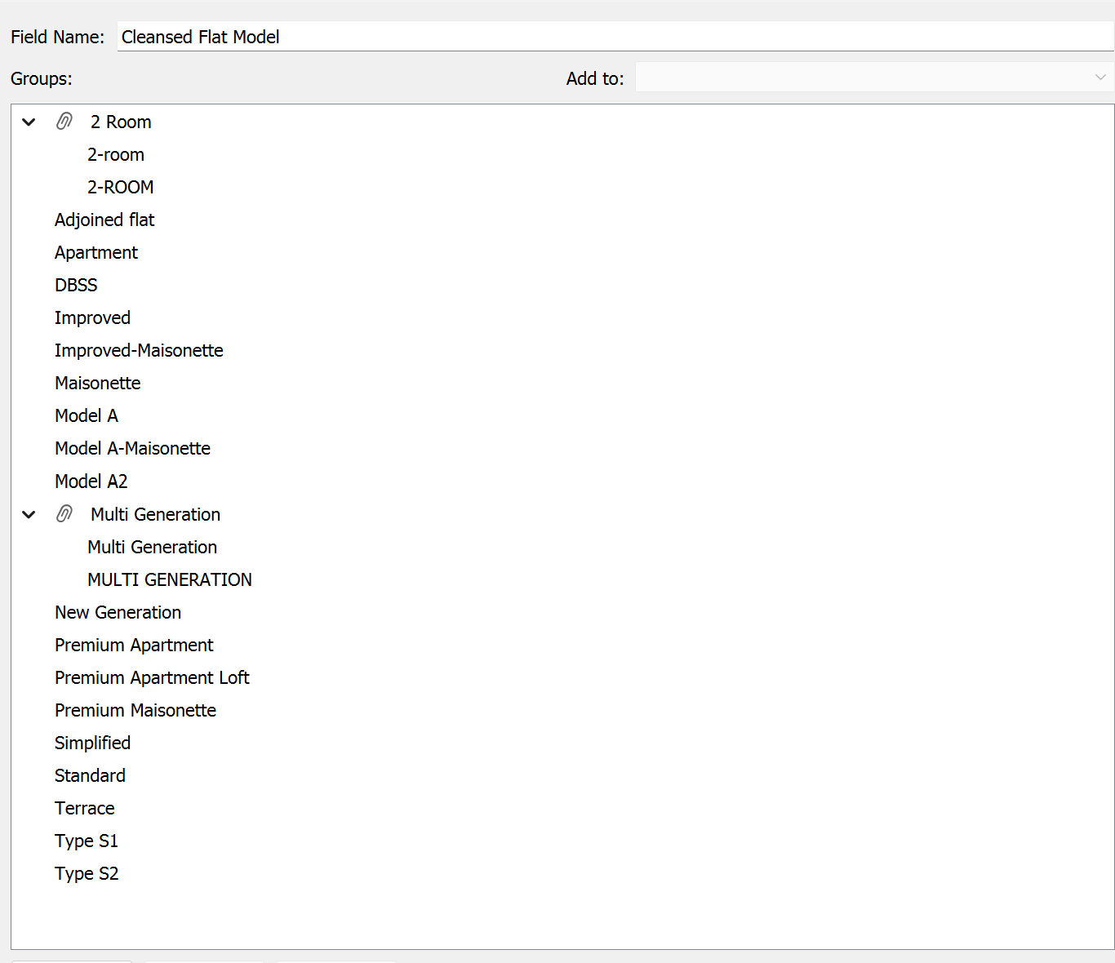
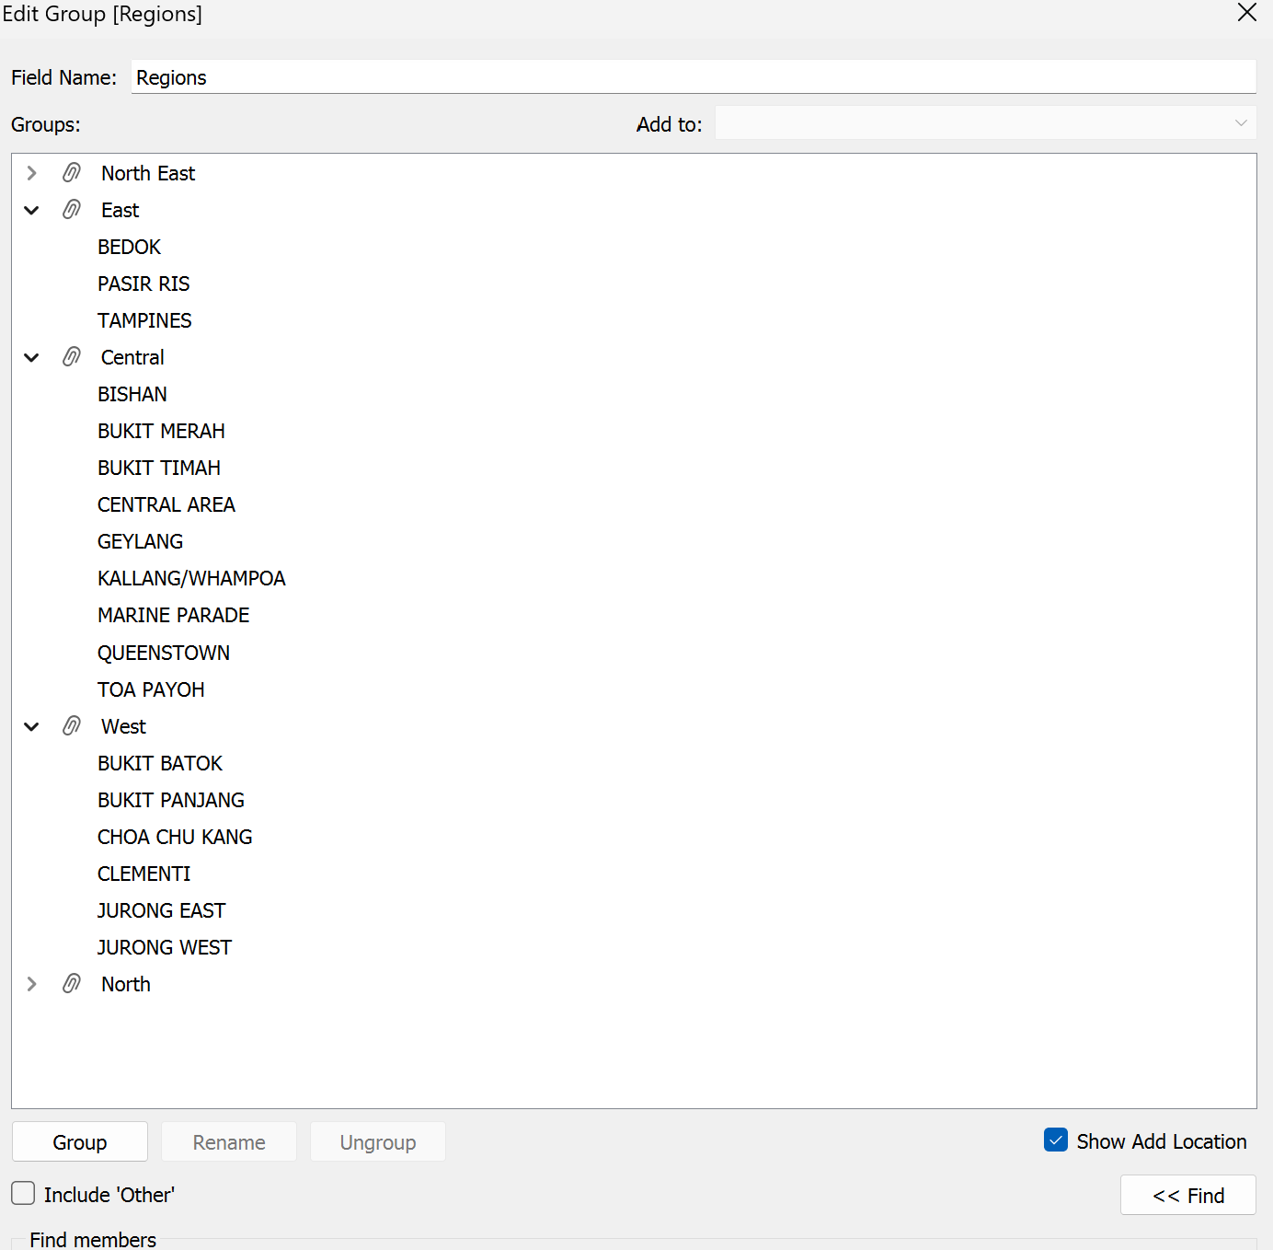
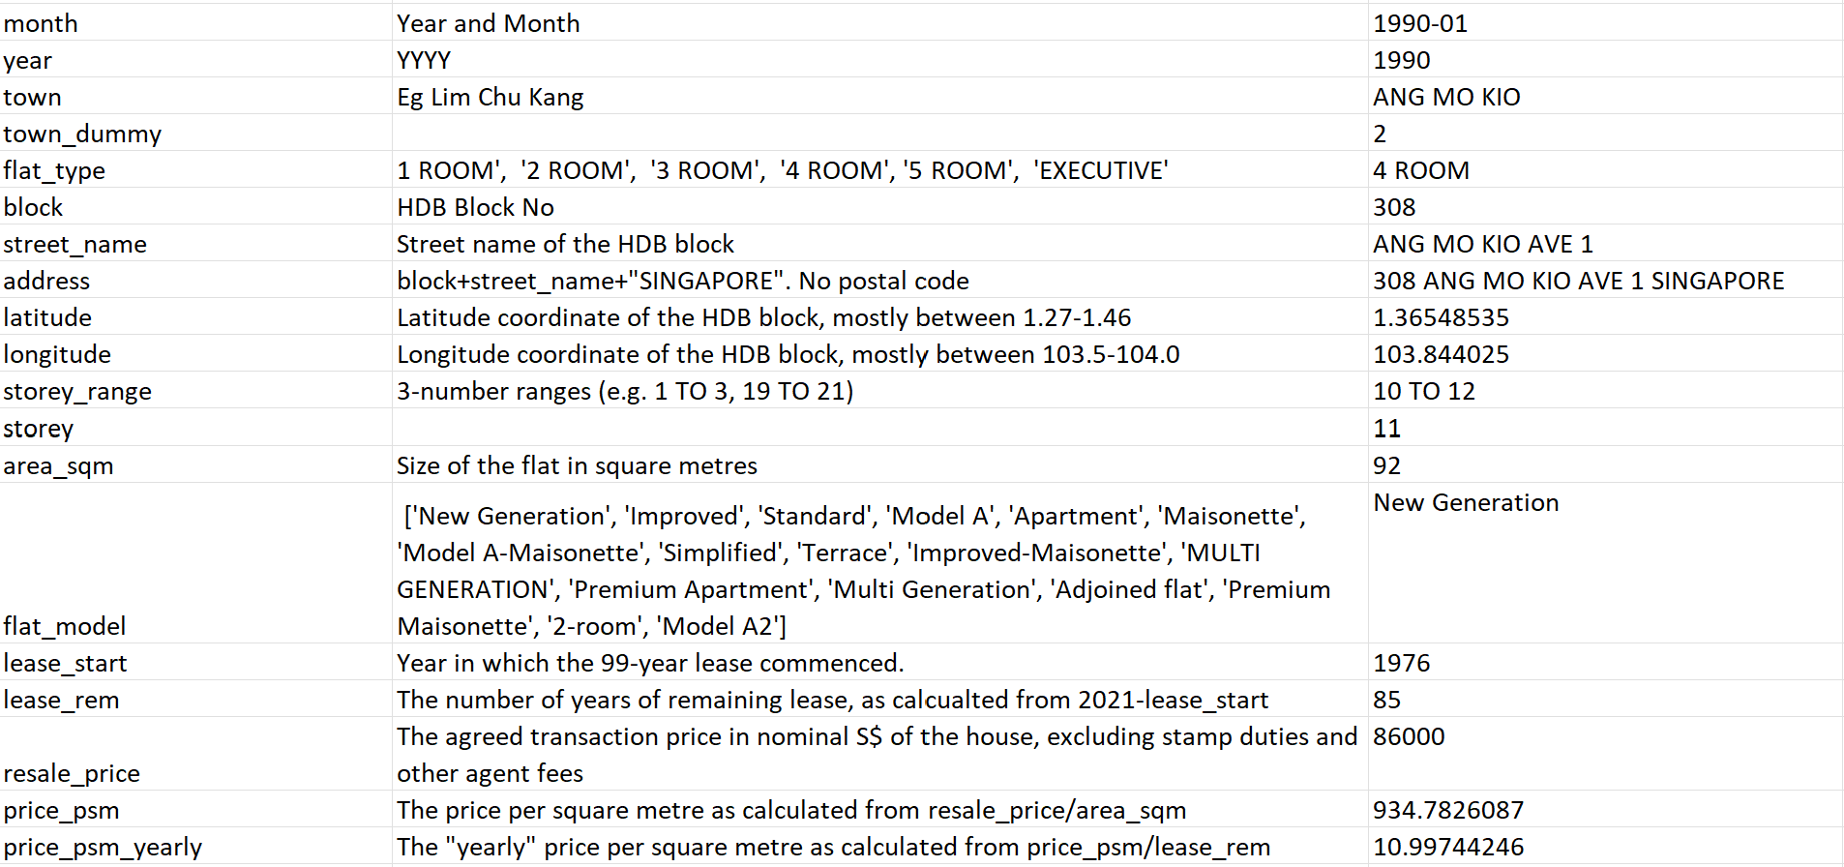
Nature of dataset & Cleansing of dataset
Field name Description Example
House Size |“Large House”, “Medium House”, “Small House” | Large House
Cleansed Flat Model | [ “2 Room”, “Adjoined flat”, “Apartment”, “DBSS”,| Adjoined Flat
| “Improved”, “Improved Maisonette”, “Maisonette”,|
| “Model A”, “Model A - Maisonette”, “Model A2”, |
| “Multi Generation”, “Premium Apartment”, | |“Premium Aparment Loft”, “Premium Maisonette”|
|”Simplified”, “Standard”, “Terrace”, “Type S1”,”TypeS2”] |
Duplicates are grouped in a single group to provide more accurate data.
Towns are grouped into separate regions in Singapore through the use of https://www.mappr.co/counties/regions-of-singapore/

Slide 4
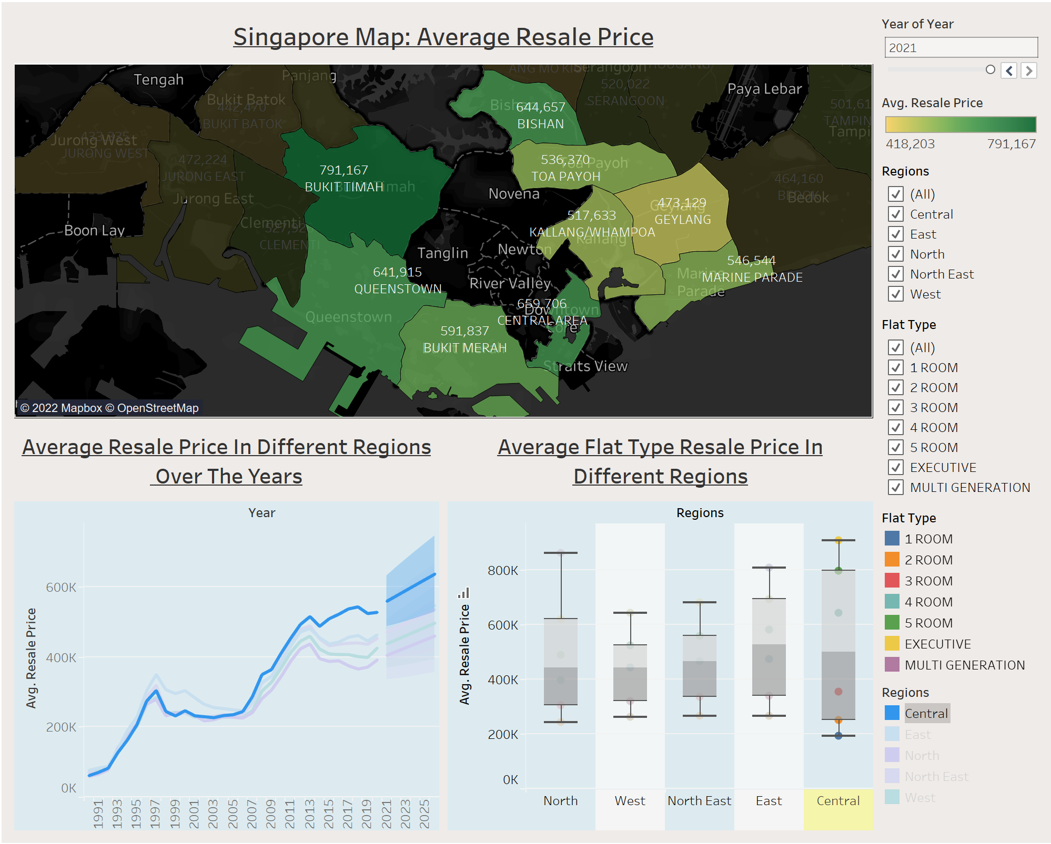
Insights: Is Singapore Housing Worthy To Invest In?
From the map, Bukit Timah is the area with highest average resale price ($791,167) and Geylang having the lowest average resale price ($473,129).
Central Region is one of the most busiest and
densely packed district in Singapore.
From the line chart, it can be seen that the Central Region increase in average resale price compared to other Region is much more significant as compared to other regions.
From the box-whisker chart, in 2021, Central Region’s Executive ($907,512), 5 Room ($794,283), 4 Room ($639,231) and 3 Room ($354,992) flat type having the highest average resale price compared to other regions.
From the box-whisker chart, the average resale price to buy a 4 ROOM flat in Central region is $639,231. However, outside of the Central region, the average price of 5 ROOM flats are only as high as an average of $579,876. Similarly, the average price to buy a 5 ROOM flat in Central region is $794,283, however outside of the central region, the average price to buy a Executive flat is only averages about $690,376. To summarise, buyers can expect to pay the full price of 5 room flat and more outside the Central region, to be able to purchase a 4 room flat in the Central Region.
Central Region contains housing that are much more expensive.

Slide 5
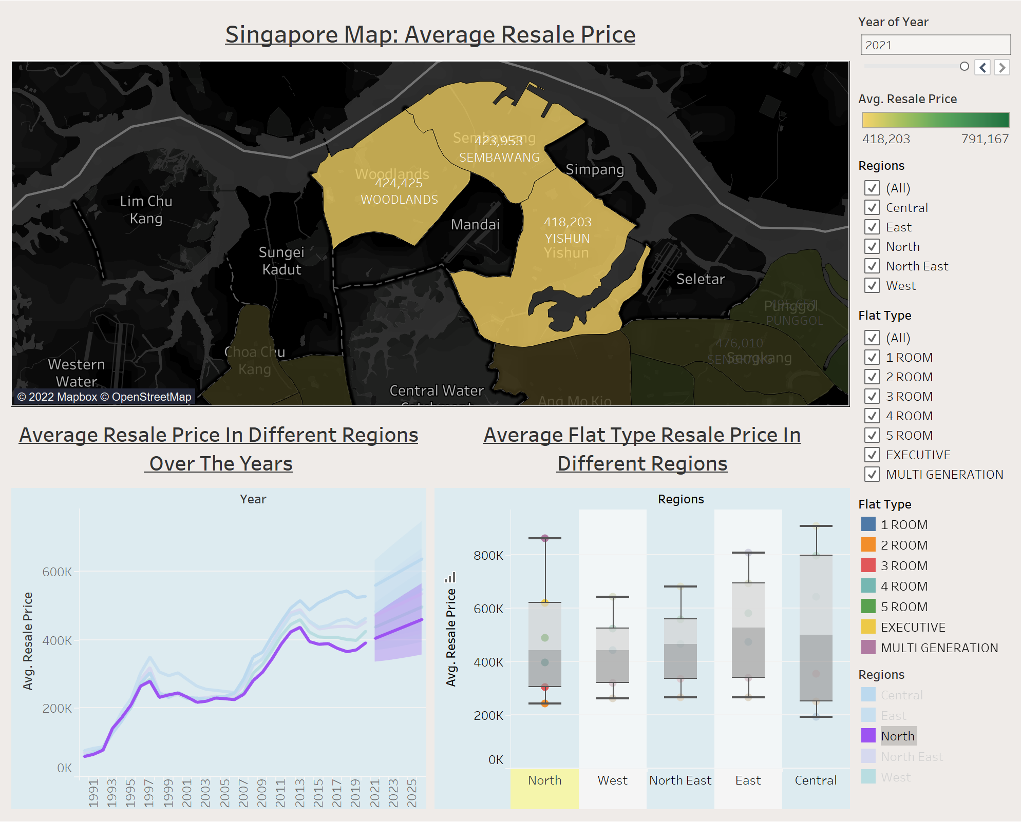
Insights: Is Singapore Housing Worthy To Invest In?
From the map, It can be seen that the North Region’s resale Price has the lowest increase of resale price over the years, compared to other regions.
From the map, the highest average resale price in the North region is Woodlands ($424,425) and the lowest average resale price is Yishun ($418,203) which tells us that the resale price do not vary much.
From the line chart, it can be seen that the North Region increase in average resale price compared to other Region is much more gradual as compared to other regions over the years
From the box-whisker chart, in 2021, North Region also have the lowest average resale price of Executive ($616,867), 5 Room Flat ($487,235), 4 Room Flat ($397,152) and 3 Room Flat($303,245) . However, with an exception of having the highest Multi Generation average resale price ($860 000).
North Region contains housing where are much more cheaper compared to the other regions.

Slide 6
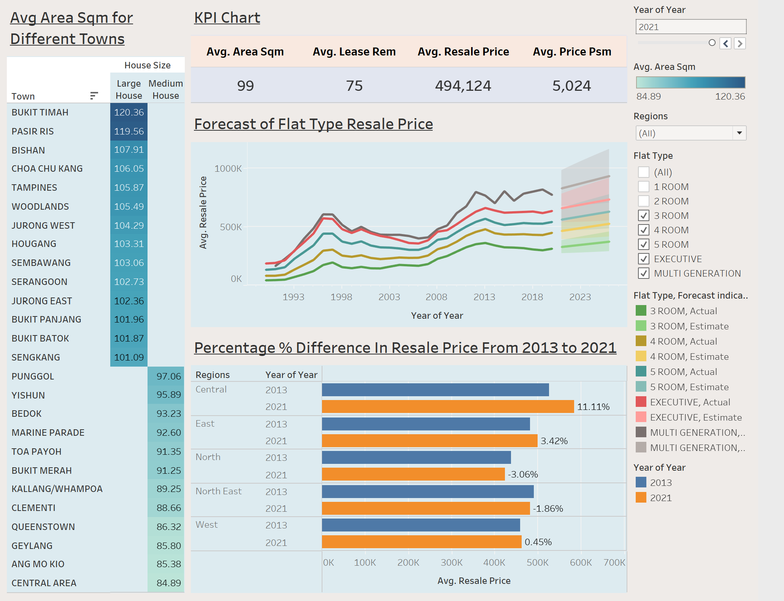
Insights: Is Singapore Housing Worthy To Invest In?
From the line chart, Flat Types of 3 ROOM, 4 ROOM, 5 ROOM, EXECUTIVE and MULTI GENERATION Average Resale Price are increasing over the years
From the bar chart, Central Region has the most dominant increase in resale price of 11.11% from Year 2013 – 2021.
However, the North and North East Region’s Average Resale Price is declining with a decrease of 3.06% and 1.86% from Year 2013 – 2021 respectively.
The KPI Chart shows the summary of the average area square meter, lease remaining, resale price and price per square meter for any town and region the user interacts with.
The highlight table shows that Bukit Timah has the largest average area square meter housing, which means Bukit Timah has one of the bigger houses in terms of space.
It is overall a good investment to buy 3/4/5 ROOM or EXECUTIVE or Multi Generation housing due to trends of rising resale prices over the years.

Slide 7
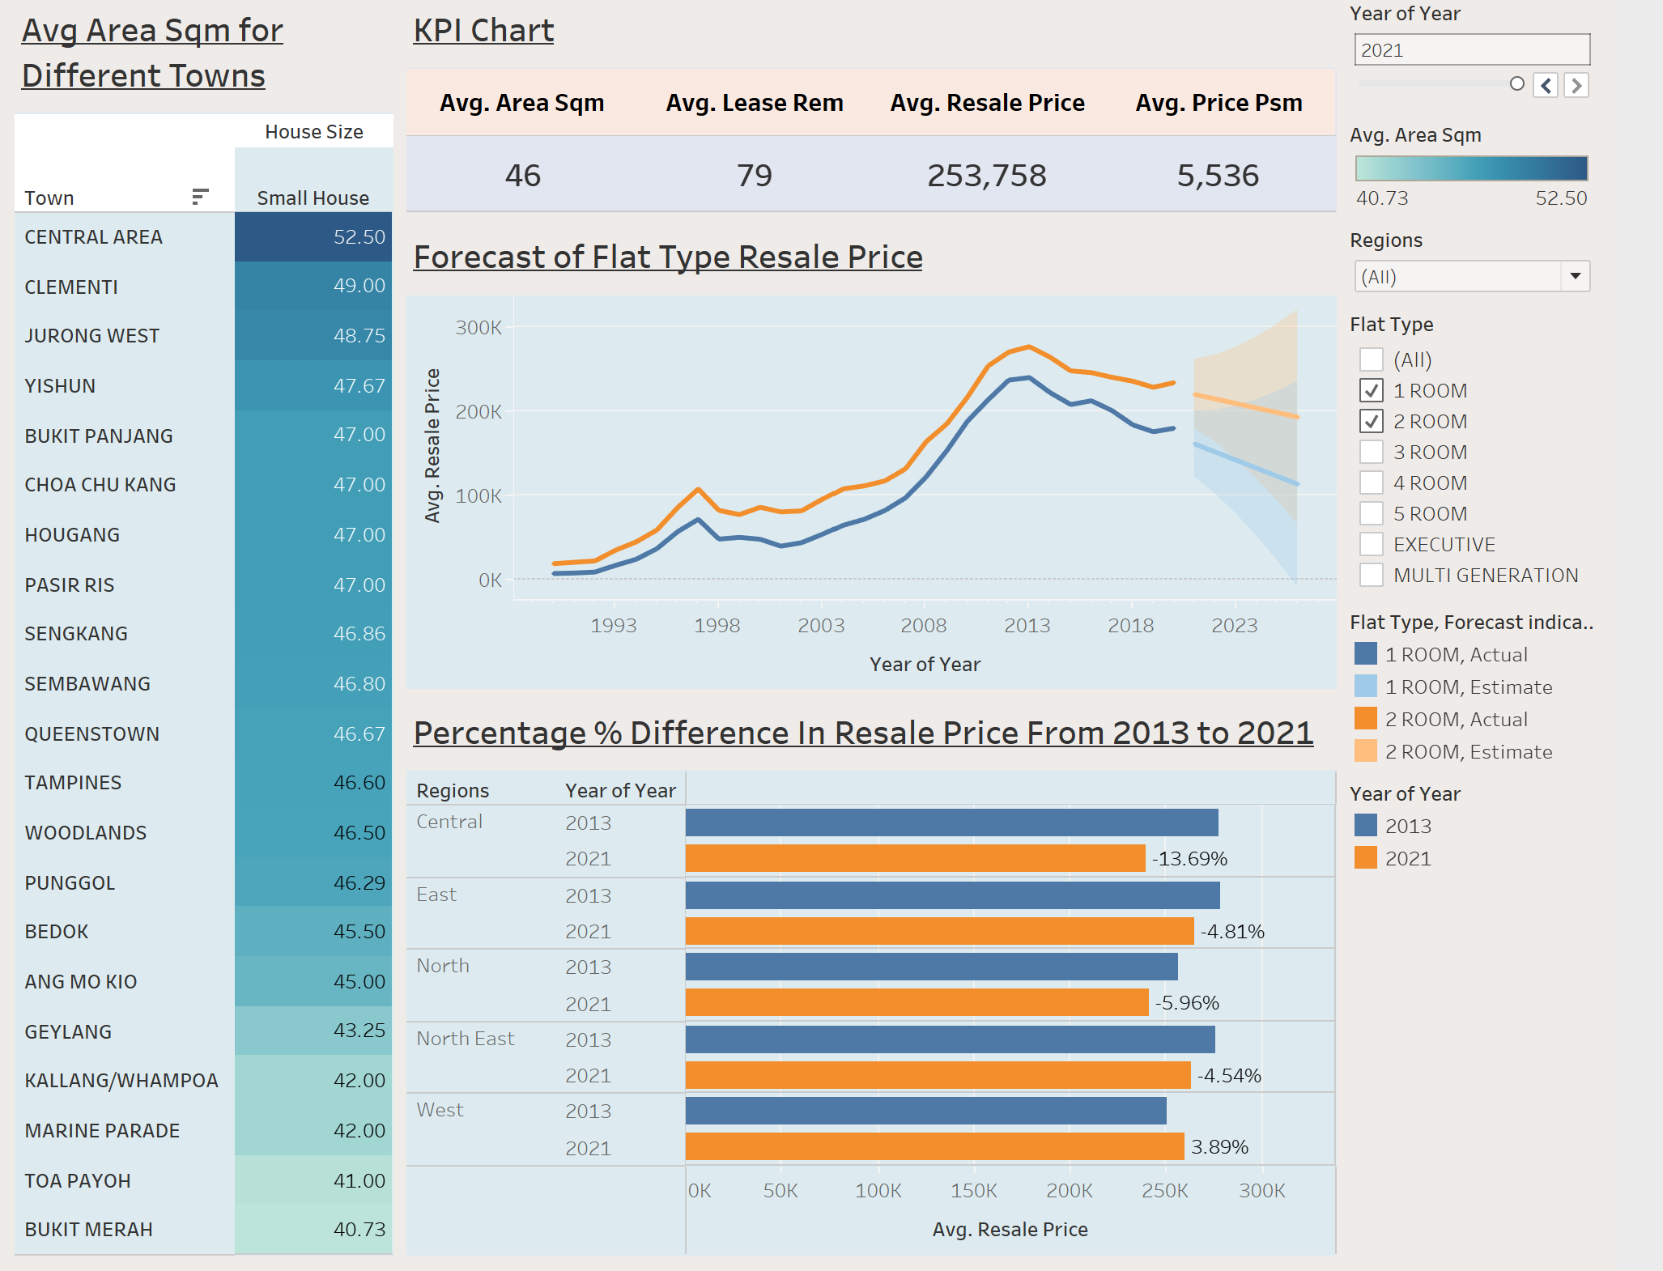
Insights: Is Singapore Housing Worthy To Invest In?
From the line chart, the 1 Room and 2 Room Flat Type’s Average Resale Price is dropping for almost every region over the Years.
From the bar chart, the Central Region has the largest percentage decrease in average resale price of 1 Room and 2 Room of 13.69%. East, North, North East also decreased by 4.81%, 5.96% and 4.54% respectively
All region’s resale price are dropping except for the West Region with a slight increase of 3.89%.
The highlight table also shows that the largest average area square meter for housing is 1 room and 2 room flat is 52.50 area square meter which is located in the central area, and the smallest is 40.73 area square meter, located in Bukit Merah.
It is not a good investment to buy a 1 ROOM or 2 ROOM housing due to falling resale price trend

Slide 8
Conclusion: Is Singapore Housing Worthy To Invest In?
It is a good time and definitely worthy to invest in a Singapore Housing due to factors such as increase demand in housing and limited land which leads to resale price increasing over the years.
All region’s housing resale price is bound to increase, with Central region increasing more significantly than other regions.
Flat types: All Flat types except for 1 ROOM and 2 ROOM are a worthy purchase to make as 1 ROOM and 2 ROOM resale prices are dropping over the Years

Slide 9
Conclusion: Is Singapore Housing Worthy To Invest In?
Recommendations:
The Government should invest more money in places where resale prices are dropping over the years. Such as in the North Area, as well as places with more 1 Room or 2 Room Flats.
The Government can build more shopping malls, MRT Stations to improve conveniency and improve its location
This way, it will allow housing with falling resale price to slowly increase over the years

Slide 10
Thank you!
Library Resource used:
1. DAVI Practical Lab and Slides
2. Regions of Singapore (2021) Mappr. Available at: https://www.mappr.co/counties/regions-of-singapore/ (Accessed: December 9, 2022).
From this CA1 Assignment, I had a fruitful experience and learnt a more in depth insight about Data Visualisation.
I am more used and comfortable when using TableAU and able to make almost any graph I need in a matter of minutes.
I have gained more experience and insight on how I can analyse data given to me

